Slide 1


Life Cycle Assessment and Comparison of Different Electrodes for Their Use in Microbial Electrolysis Cells
Nicoly Welter CSC593

Slide 2

1. Introduction
Microbial Electrolysis Cells (MECs) are processes that combine the treatment of wastewater with the simultaneous generation of value-added chemicals, such as hydrogen.
The efficiency of the MECs depends of several factors such as the substrate, the bacterial inoculum, the set-up configuration, and the characteristics of the electrodes.
The material and surface characteristics of the electrodes can interfere in the biocompatibility, bacterial adhesion and mass, and electrodes transfer, therefore fully affecting the hydrogen production.

Slide 3
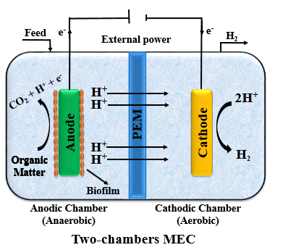
2. Goal
The goal of this Life Cycle Assessment is to compare the overall environmental impacts associated with the use of a Platinum/Carbon electrode and a Stainless Steel electrode for wastewater treatment and hydrogen gas production.

Slide 4
3. Methods
The impact assessment was conducted based on the ReCiPe Midpoint (E) V1.13 methods, and the following categories were analyzed: Climate Change Impact, Terrestial Acidification, Freshwater Eutrophication, Human Toxicity, Ozone Depletion and Photochemical Oxidant Formation Potential.
The electrodes information was obtained from the paper “Nutrient recovery and energy production from digestate using microbial electrochemical technologies (METs)” published on the Journal of Cleaner Production by Pepè Sciarra et al. (2019).

Slide 5
3. Methods
Table 1 – Main characteristics of each electrode
Platinum | Stainless Steel
A= 7 cm² | A= 7cm²
2.8 mg of Pt | Փ_{mesh} = 1 mm
140 mg of Carbon cloth | 10000 mg
98 μL of binder PTFE = 0.22 mg
30 min at 350°C = 2.5 kwh
Pepè Sciarra et al. (2019).

Slide 6
4. Results
Table 2 – Overall difference between the different electrodes in each impact category
Impact category | Stainless Steel | Platinum | Δ
Global Warming (CO2-eq) | 0.018066 | 1.941508 | 107.47x
Terrestial Acidification (SO2-eq.) | 0.000078 | 0.019214 | 246.33x
Freshwater Eutrophication (P-eq) | 1.028305e-06 | 0.000153 | 148.79x
Human Toxicity (1,4- DCB-eq) | 0.119789 | 8.742151 | 72.98x
Ozone Depletion (CFC-11-eq.) | 7.981917e-10 | 8.484071e-08 | 106.29x
Photochemical Oxidant Formation (C2H4-eq.) | 0.000116 | 0.009186 | 79.19x
Pepè Sciarra et al. (2019).

Slide 7
4. Results
Table 3 – Overall difference in the MECs efficiencies using the different electrodes
Parameter | Stainless Steel | Platinum | Δ
PO₄³⁻ removal | 21.4 ± 1.4 | 30.83 ± 0.79 | +1.44x
NH₄⁺ removal | 9.86 ± 0.73 | 4.52 ± 0.45 | -2.18x
COD removal | 27.64 ± 1.78 | 39.81 ± 2.34 | +1.44x
Coulombic Efficiency | 107 ± 3.1 | 99 ± 4 | -1.08x
Electrical Efficiency | 186.4 ± 3.2 | 192.3 ± 2.6 | -1.03x
Overall Efficiency | 60.8 ± 1.1 | 38.5 ± 0.4 | -1.57x
Hydrogen yield (lkg_{H2} kg_{sub}⁻¹) | 0.13 ± 0.00 | 0.14 ± 0.003 | +1.07x
Pepè Sciarra et al. (2019).

Slide 8
5. Conclusions
The MEC system with the Platinum electrode presented a 1.44 times higher COD and PO₄³⁻ removal, and 1.07 times higher hydrogen production than the one using a Stainless Steel electrode.
However the Platinum system was overall 127 times more environmentally impactful than the SS system.
Considering the sustainability and the higher price of the Platinum electrodes, for this case in specifics, it would no be worth it to invest on Pt electrodes.

Slide 9
THANK YOU!

